Slide 1

EXPLOTARY DATA ANALYSIS OF AIRPLANE BIRD STRIKES
Görkem İpek
21290312

Slide 2
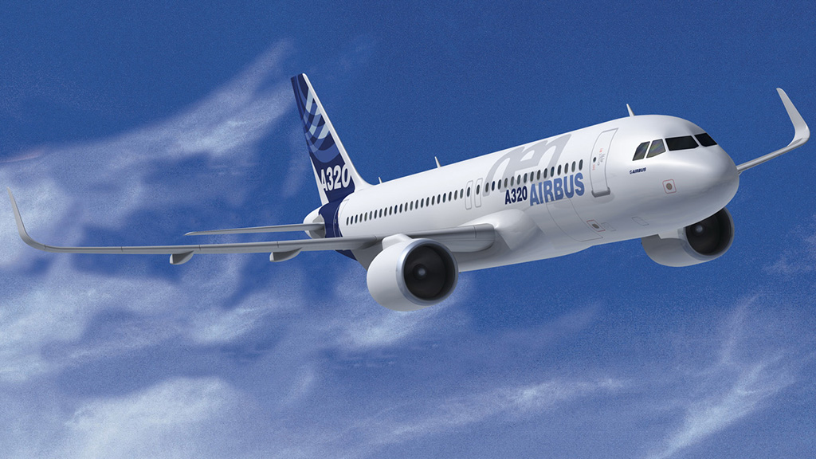
Understanding the Data
At first step we needed to understand what is our data. It is quite easy dataset we can have some guesses and plot graphics to see everything we need.

Slide 3
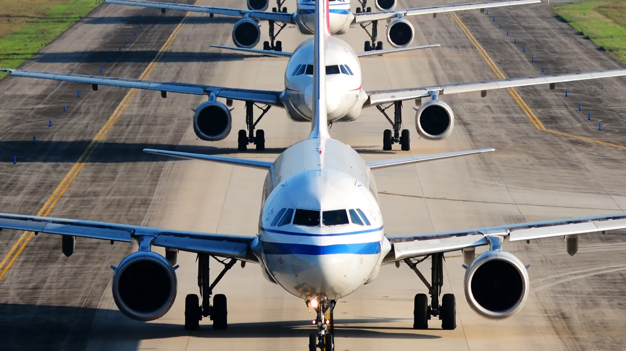
AIRCRAFT TYPE
In our data all of our aircrafts are airplanes. So we don’t have to worry about that.

Slide 4
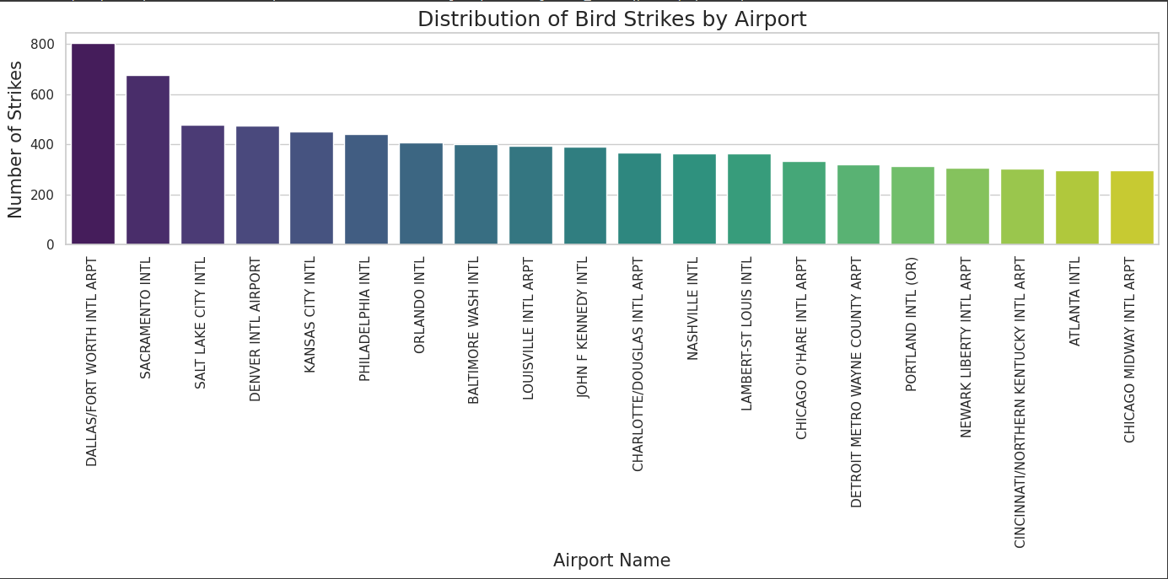
AIRPORTS
Airports are definetely is an important factor since it decides if birds live in area. We can see that in our graphic as well.

Slide 5
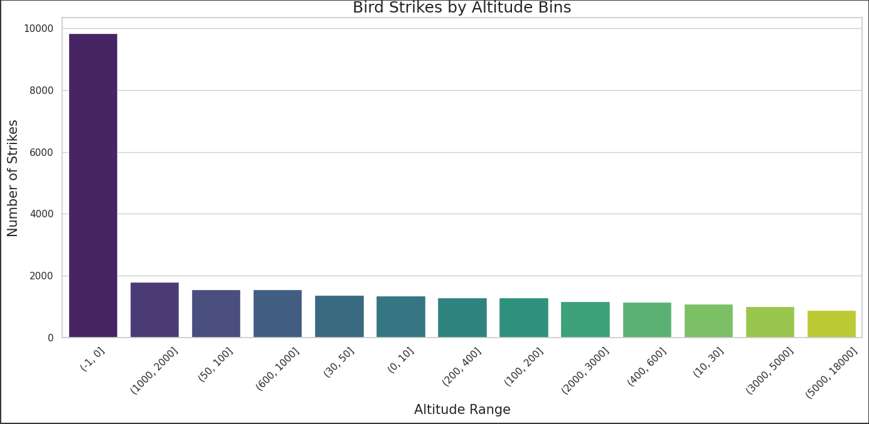
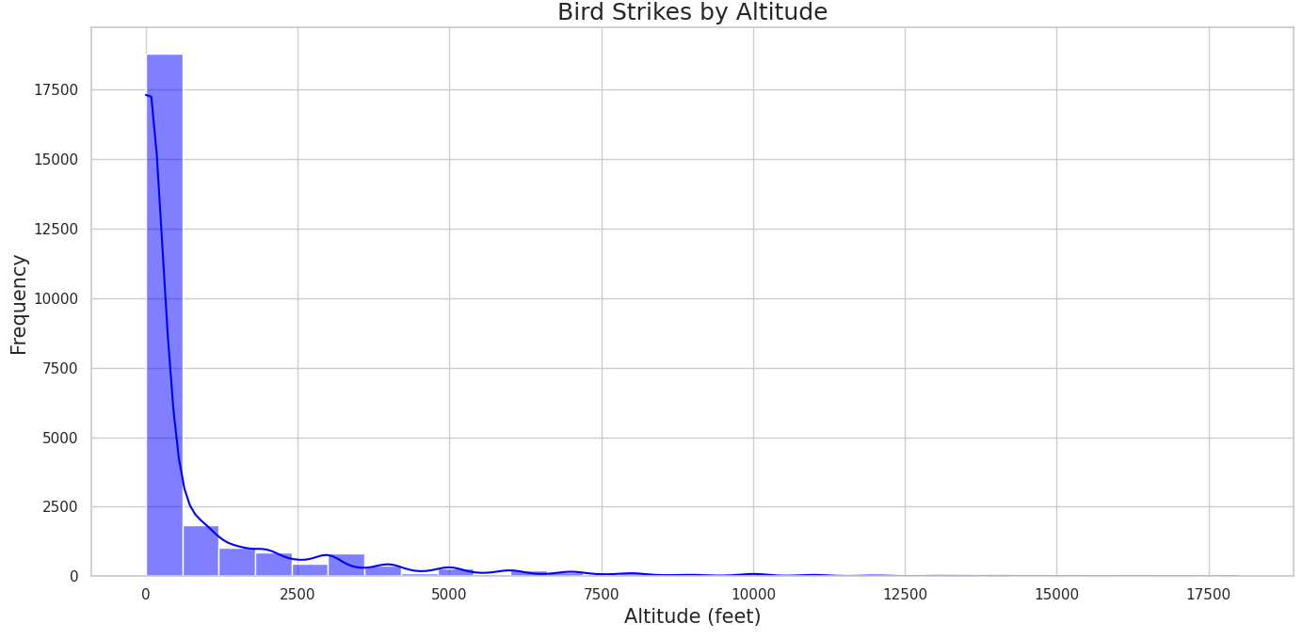
ALTITUDE
Birds cannot live in higher altitudes due to less oxygen and freezing colds. I thought bird strikes should happen in lower altitudes. I was right.

Slide 6
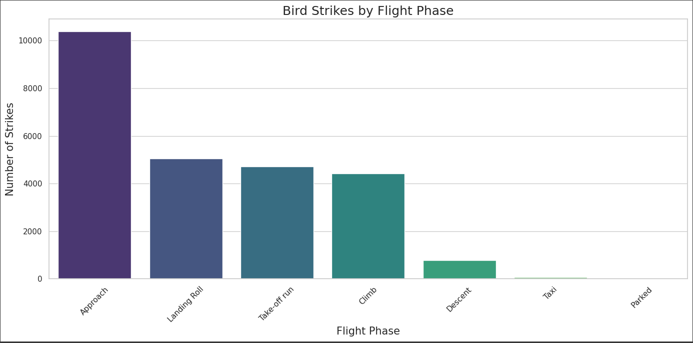
FLIGHT PHASE
After we checked altitudes we can actually know in which flight phases a bird strike may occur more likely.

Slide 7
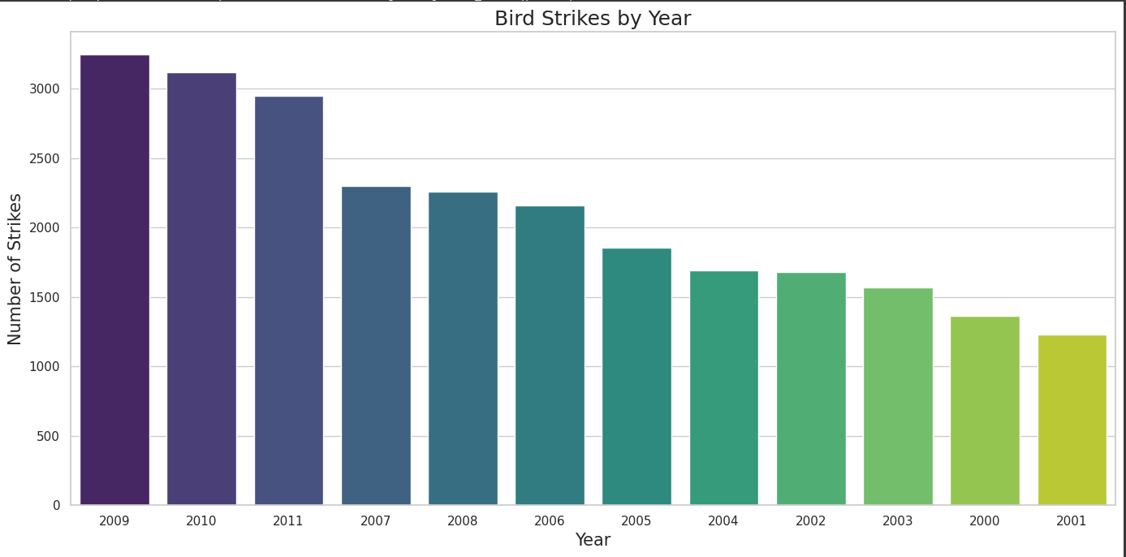
YEAR
This one quite surprised me as I didn’t think there would be differences in bird strikes by year. We can see there is nearly a thousand bird strike difference between 2009 and 2008.

Slide 8
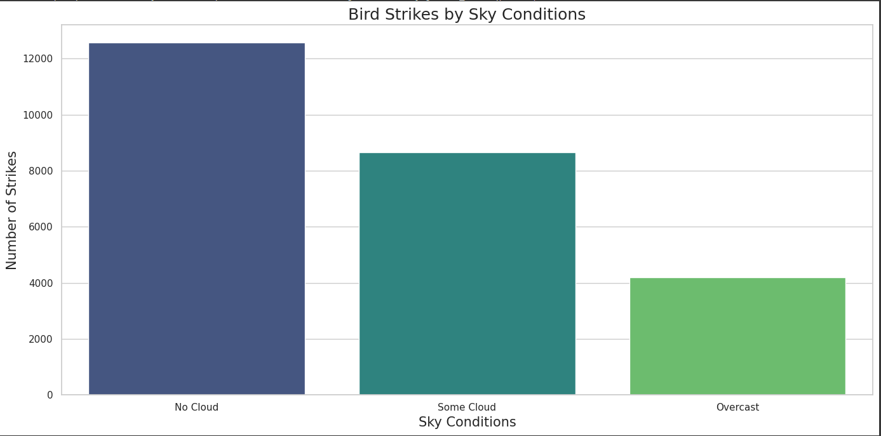
SKY CONDITIONS
This one surprised me the opposite way. I thought when there were no clouds bird strikes should be less likely but it’s quite the opposite in our dataset.

Slide 9
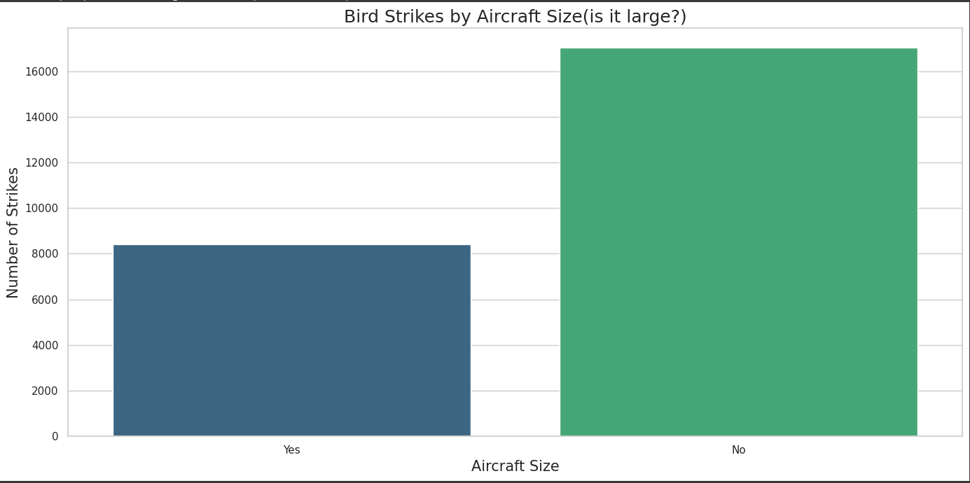
AIRCRAFT SIZE
It is interesting that large airplanes doesn’t get more bird strikes. Before the graphic I thought there would be more bird strikes but it’s vice versa.

Slide 10
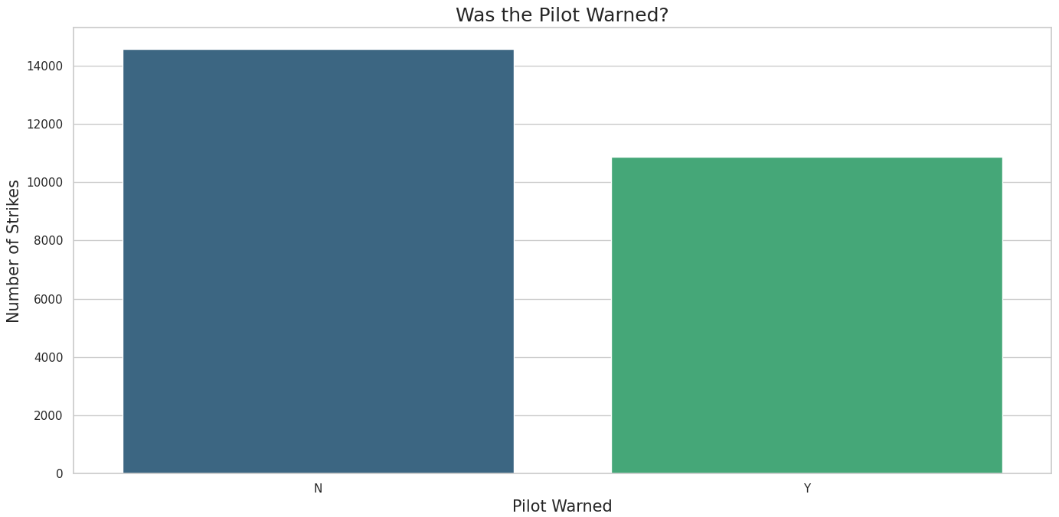
WAS THE PILOT WARNED?
It reduces the chance of a bird strike if pilot is warned.

Slide 11
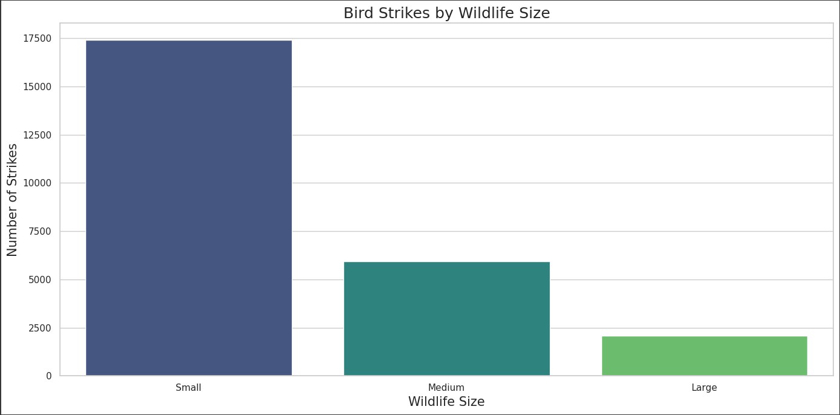
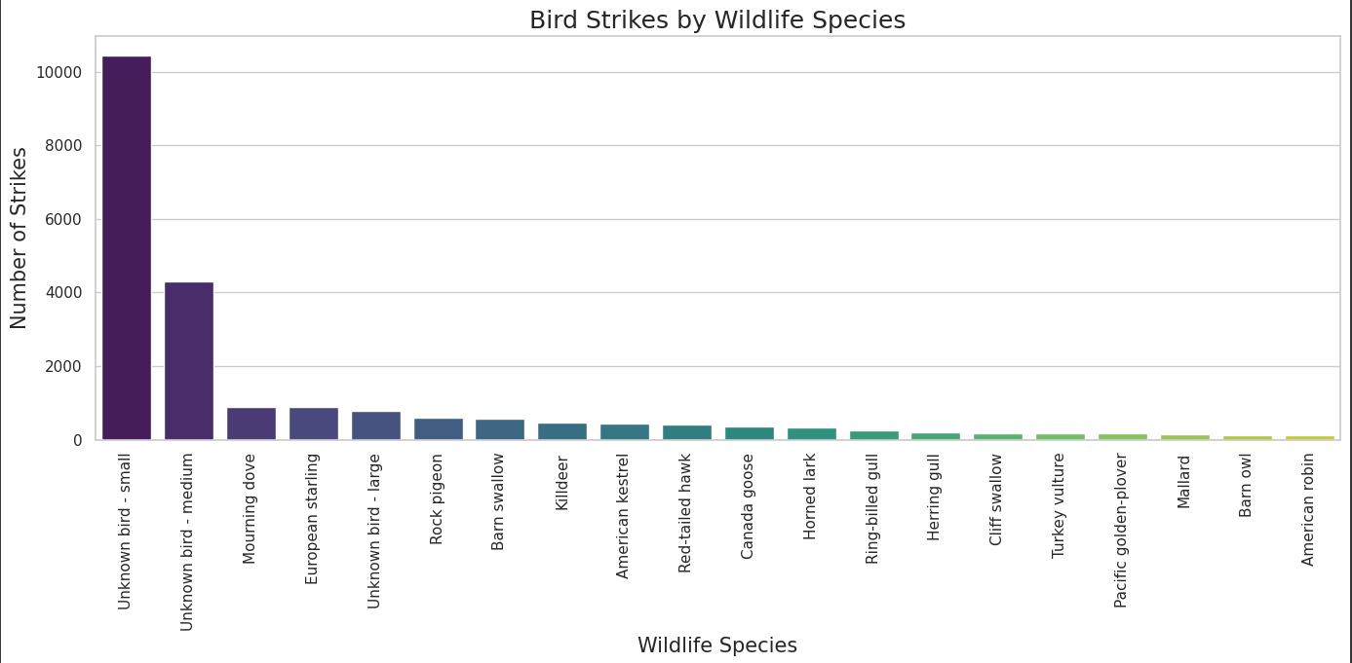
WILDLIFE SPECIES AND SIZE
We can see that small birds cause most of bird strikes.

Slide 12
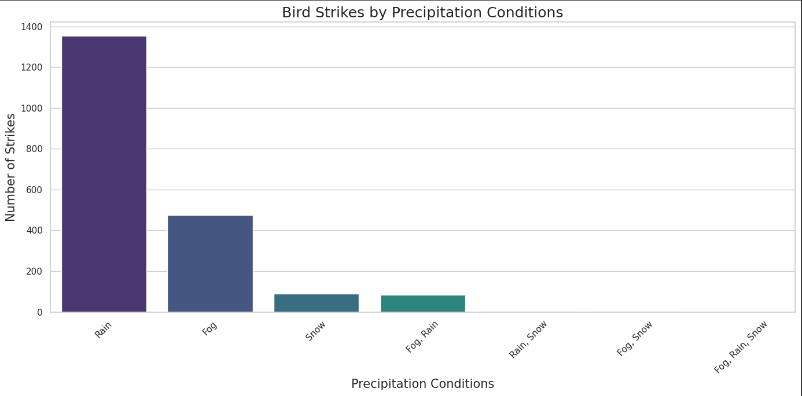
PRECIPITATION CONDITIONS
About precipitation conditions I thought fog should cause most of the bird strikes but it is actually rain as we can see from graphic.

Slide 13
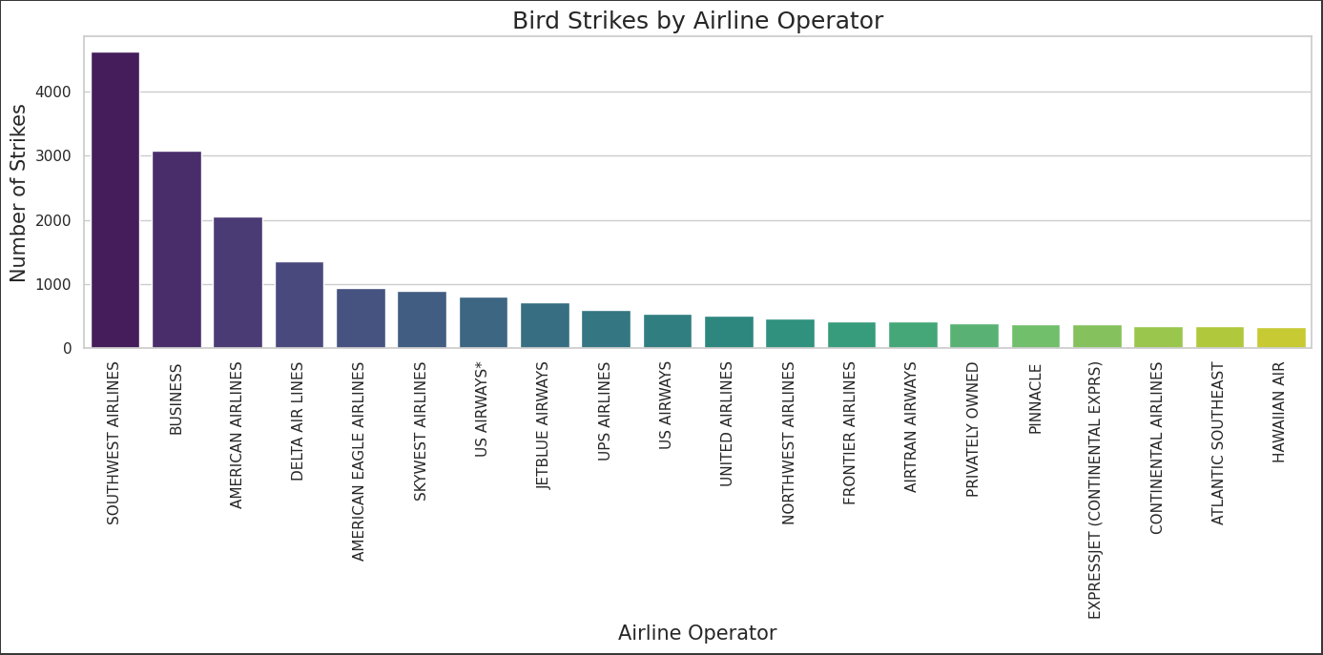
AIRLINE OPERATOR
This one is also a surprising one as airline operator shouldn’t be a factor in bird strikes. It may be because of the operating countries ( if birds live there).

Slide 14
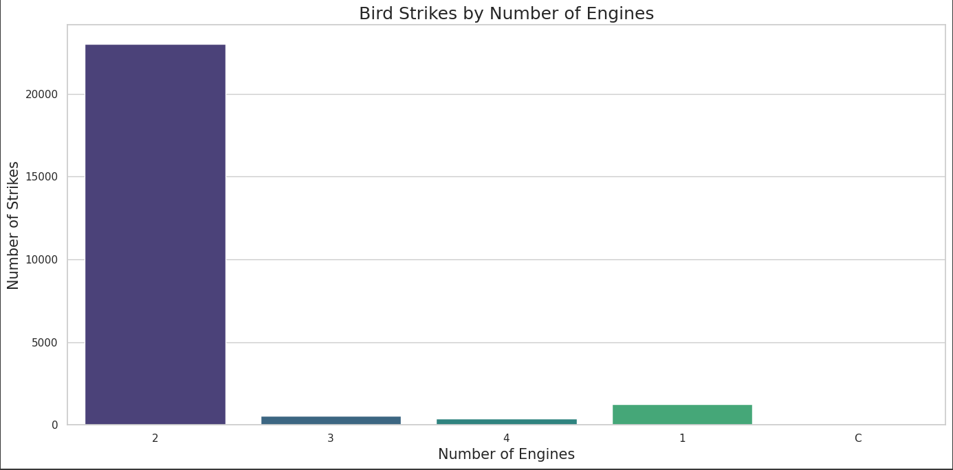
NUMBER OF ENGINES
Another one that surprised me as more motors means more places birds can get into. But in this one data is not giving the exact scenarios because there are more 2 engine airplanes than 1, 3, 4 engine airplanes by a high margin.

Slide 15
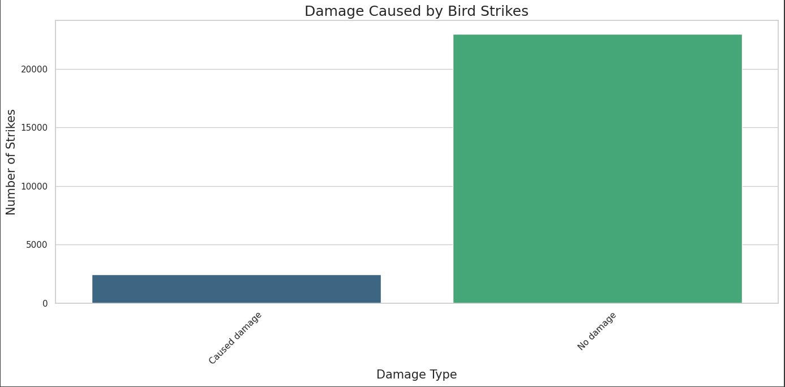
DAMAGE CAUSED
Airplanes are designed to endure bird strikes. This leads to mosf of the bird strikes don’t do any damage.

Slide 16
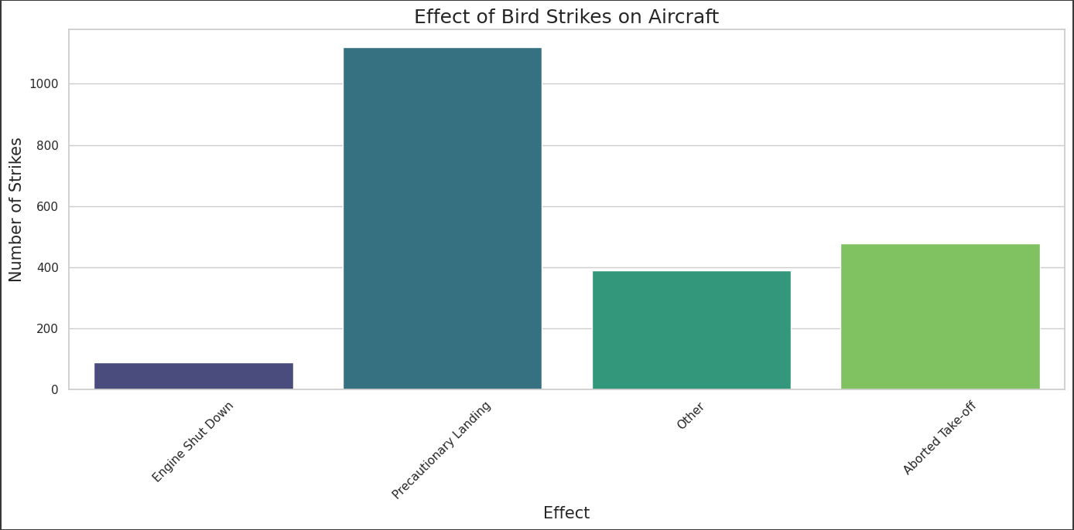
EFFECT OF DAMAGES
From last graphic we may think the damaged planes crash but again due to airplanes being a marvel of engineering they can still make it to ground.

Slide 17
CONCLUSION
We didn’t check everything in the dataset but we checked important data from our dataset using graphics. There were some obvious and some surprise facts. Dataset is not new neither it has enough data when we think of roughly 21000 bird strikes every year. But overall it is quite great dataset for a basic work.

Slide 18
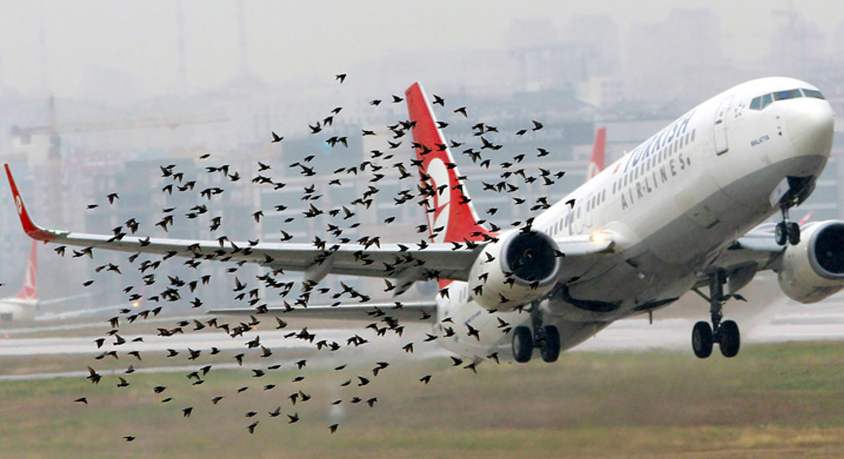
THANK YOU

